Slide 1

SE495 Project
MONITORING AND DETECTING CYBER ATTACKS BASED ON TRAFFIC DATA AND DNS INFORMATION
By: Ramy gamal
01

Slide 2

SE495 Project
INTRODUCTION
Cybersecurity threats are rapidly evolving, becoming more frequent and sophisticated. Traditional rule-based systems struggle to detect complex or zero-day attacks and often suffer from bias due to imbalanced datasets. This project leverages machine learning to analyze network traffic and DNS data in real time, aiming to accurately detect and classify cyberattacks based on features like packet size, duration, and timestamps.
02

Slide 3

SE495 Project
OBJECTIVES
Develop ML Models: Train machine learning models for both binary (normal vs. malicious) and multi-class (e.g., botnet, DDoS, DGA) classification of network traffic.
Evaluate and Compare Models: Assess model performance using key classification metrics to identify the best-performing approach.
Analyze Feature Importance: Use model-based methods (tree-based and linear) to determine which features most influence cyberattack detection.
03

Slide 4

SE495 Project
DATASET
Dataset Overview:
Source: Stratosphere IPS Project (CTU-13 & Zeus datasets)
Format: Combined CSV from 3 binetflow files
Size: 130,502 samples, 17 features
Target Variable: attack_type (e.g., normal, botnet, DDoS, DGA)
Key Features:
StartTime, Dur (duration), Proto (protocol)
SrcAddr / DstAddr (source/destination IP)
Sport / Dport (ports)
TotPkts, TotBytes (traffic volume)
04

Slide 5

SE495 Project
PREPROCESSING
Handling Missing Values in Numeric Columns: Median imputation
Handling Missing Values in Non-Numeric Columns: Mode imputation
One-Hot Encoding: Label encoding was used for any categorical data
Dropping Irrelevant Columns: The ‘Label’ column was dropped for redundancy.
Feature Scaling: Numeric features were standardized using StandardScaler, to ensure that all features contribute equally to the analysis.
05

Slide 6

SE495 Project
FEATURE ENGINEERING
To prepare the dataset for machine learning models, several preprocessing steps were performed:
1) StartTime Feature Engineering: The StartTime column was converted into datetime objects to extract meaningful temporal patterns. Extracted features include:
hour: Hour of the connection
day_of_week: Day name (e.g., Monday)
is_weekend: Indicates if the connection occurred on a weekend
These features help capture time-based attack trends, such as higher activity during work hours or specific weekdays.
06

Slide 7
SE495 Project
FEATURE ENGINEERING
2) Categorical Encoding: Categorical variables were transformed using Label Encoding to make them suitable for ML models, which typically require numerical input.
Key encoded features include:
Proto (protocol)
Dir (direction)
State (connection state)
3) Feature Selection: The Label column was removed as it duplicated information already captured in the attack_type target variable, helping to avoid redundancy.
07

Slide 8

SE495 Project
TRAINING & EVALUATION
Models Trained
1-Logistic Regression 2-Random Forest 3-Gradient Boosting 4-SVM 5-Neural Network (Multi-layer Perceptron classifier) 6-Neural Network (Deep Learning)
Train-Test Split
70% training & 30% testing
Evaluation Metrics
-Primary: F1-score (weighted and macro)
2-Secondary: Precision, recall, confusion matrices.
08

Slide 9
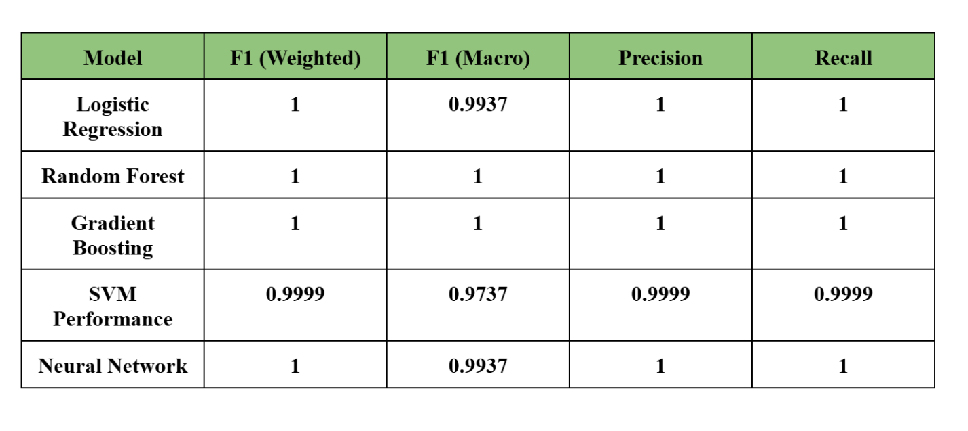
SE495 Project
RESULTS
This table summarizes the performance of various machine learning models for a classification task using four key metrics: F1 (Weighted), F1 (Macro), Precision, and Recall.
09

Slide 10
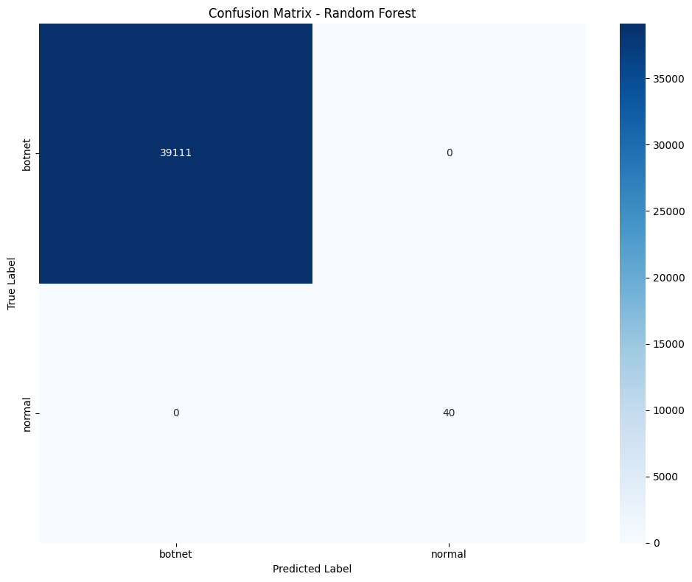
SE495 Project
RESULTS
10
39,111 botnet samples were correctly classified as botnet. 40 normal samples were correctly classified as normal. Zero misclassifications — no false positives or false negatives.

Slide 11
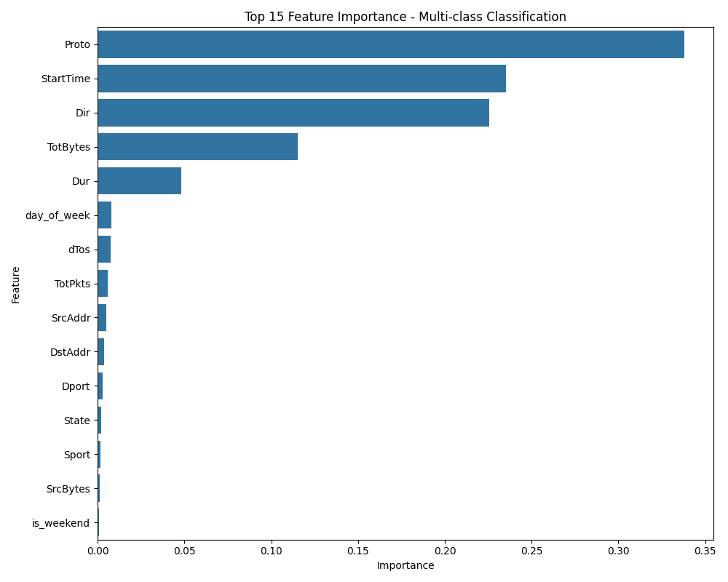
SE495 Project
FEATURE IMPORTANCE
11

Slide 12

SE495 Project
CONCLUSION
In this project, I was able to develop and evaluate multiple machine learning and deep learning models for cyber attack detection based on network traffic data. All models performed exceptionally well which demonstrates the effectiveness of machine learning approaches for cybersecurity applications. The Random Forest classifier emerged as the optimal model, achieving perfect scores across all evaluation metrics for both binary and multi-class classification tasks. Key features like total bytes, source bytes, and Total packets were critical. The dashboard enables real-time monitoring, aiding security teams in threat response.
02

Slide 13
SE495 Project
THANK YOU
13

